Slide 1



WELCOME
LNHS PTSA
GENERAL MEETING
WEDNESDAY
MAY 20, 2026
MEDIA CENTER
81010
@ptsalnhs
www.LNHSPTSA.com

Slide 2


Slide 3

PAST MINUTES
FEBRUARY 18, 2026
Nominating Committee Elections

Slide 4

APRIL 2026
FINANCIAL REPORT
Starting Balance - $1,115.33
Ending Balance - $3,937.99
THANK YOU!

Slide 5
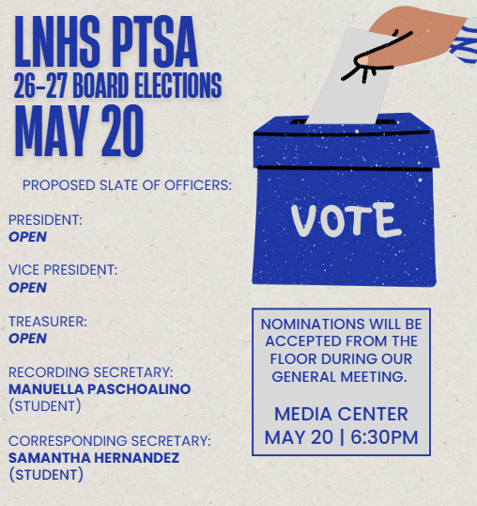
ANNUAL BOARD
ELECTIONS

Slide 6


Slide 7

Help Us
Meet Our Goal
of 300 Memberships!
Parents - 95
Staff - 62
Students - 64
Community - 10
231
Memberships

Slide 8



AVAILABLE ONLINE UNTIL 5/29!

Slide 9

LEGACY
BRICKS
Orders have been placed.
Installation is expected
the first week in June.

Slide 10
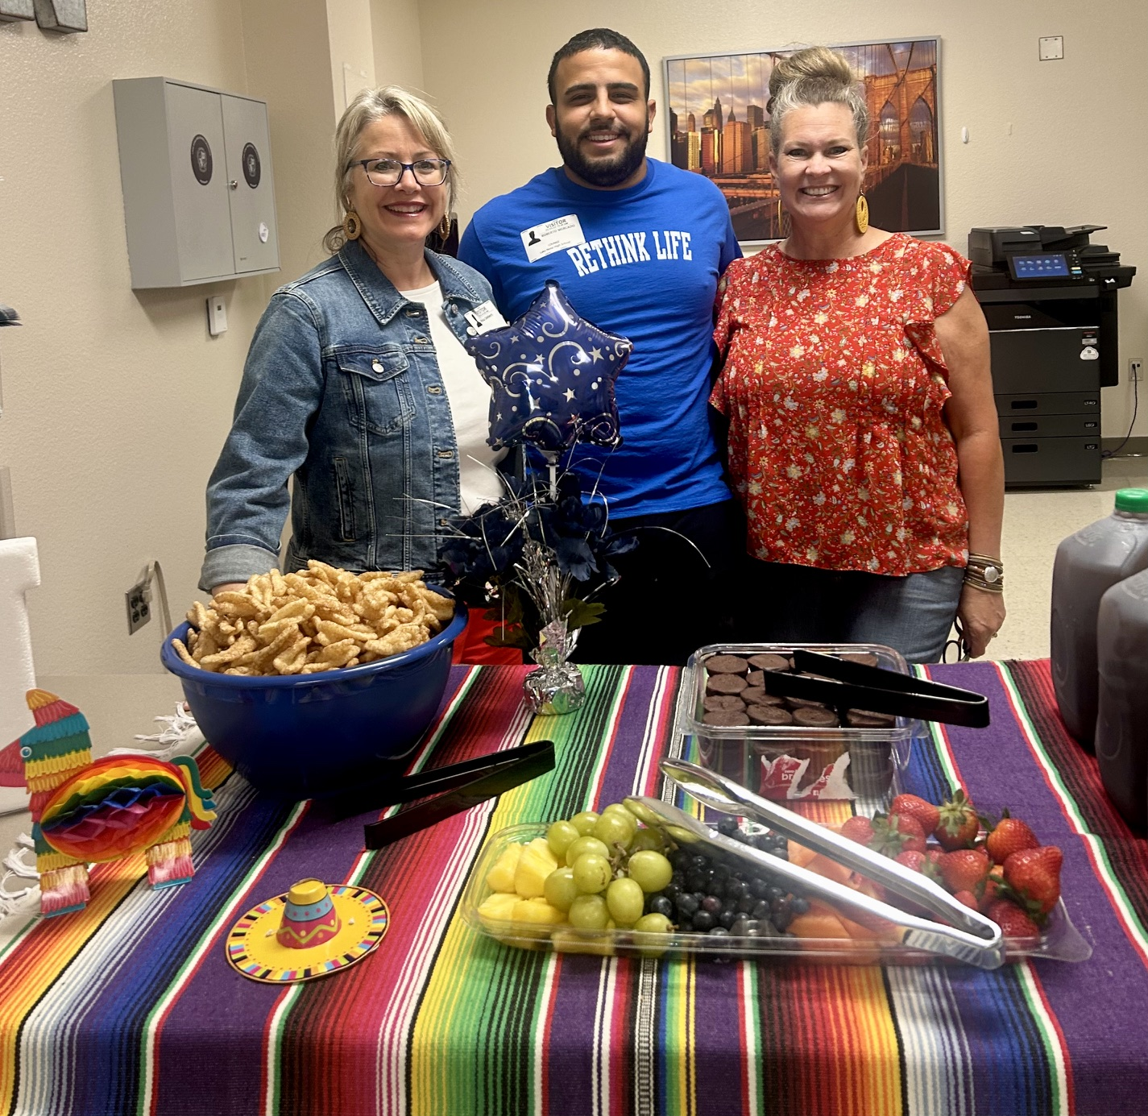
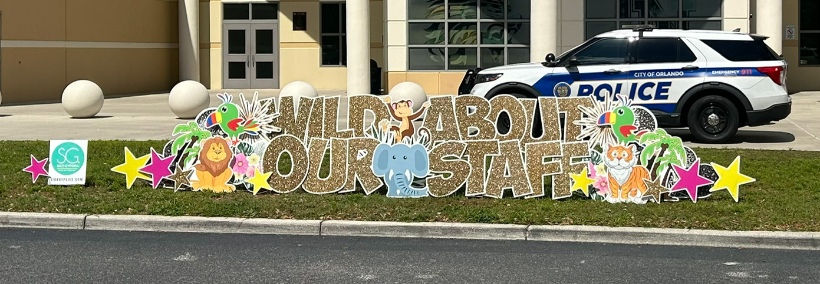
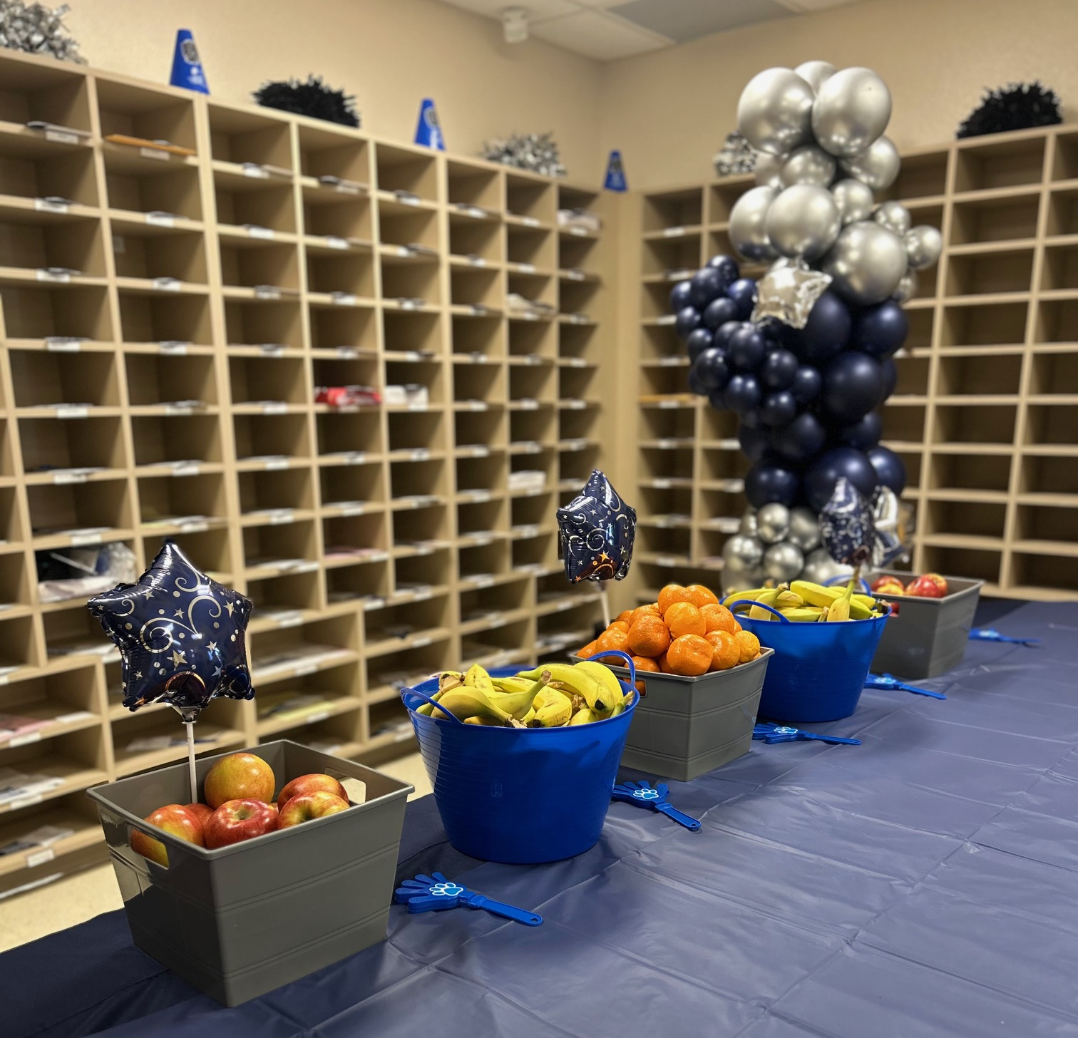
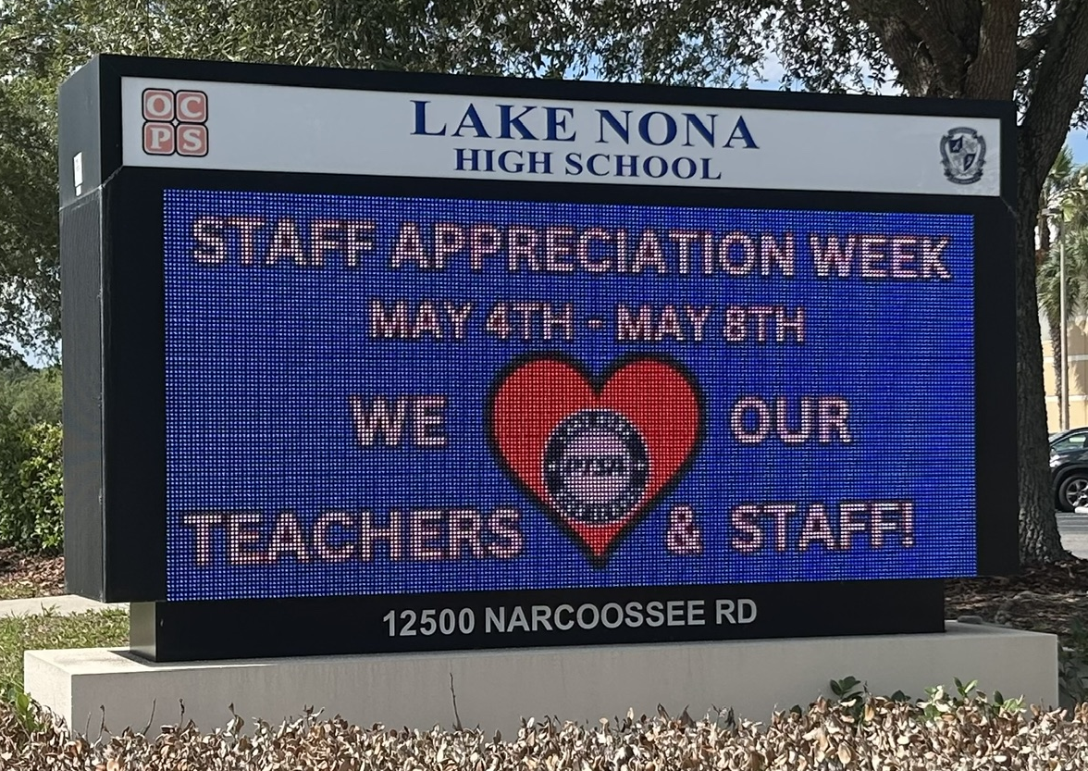

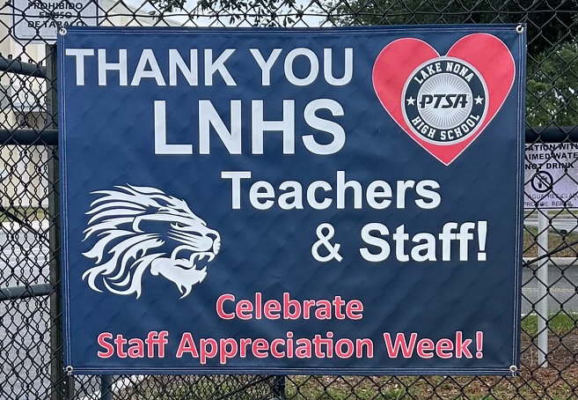
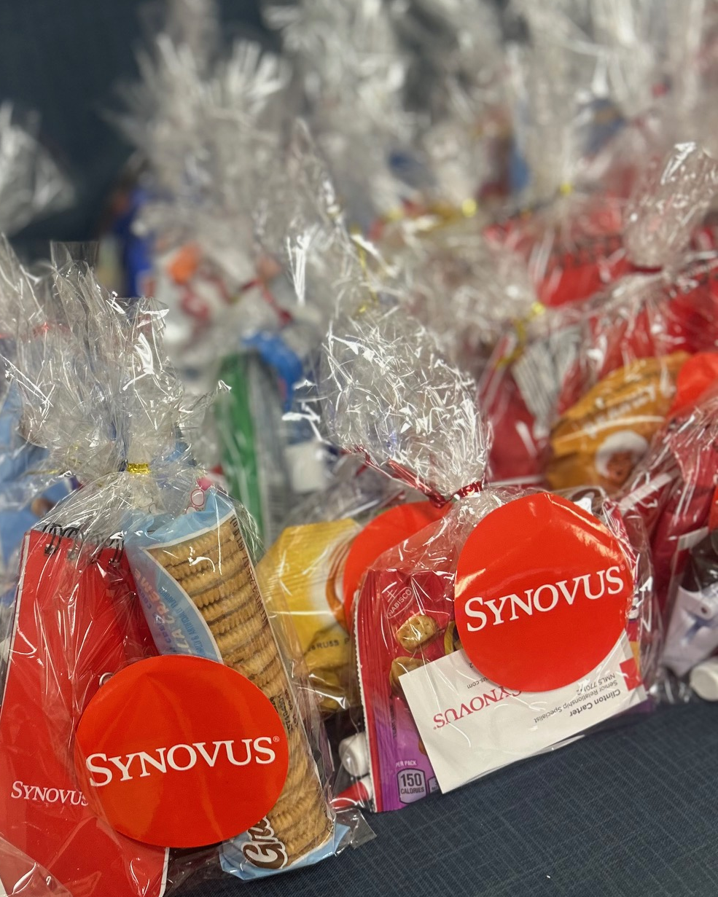
STAFF
APPRECIATION
WEEK
Thank You
Community Sponsors

Slide 11
LEARN WITH LIONS
Virtual Tutoring Club

Slide 12
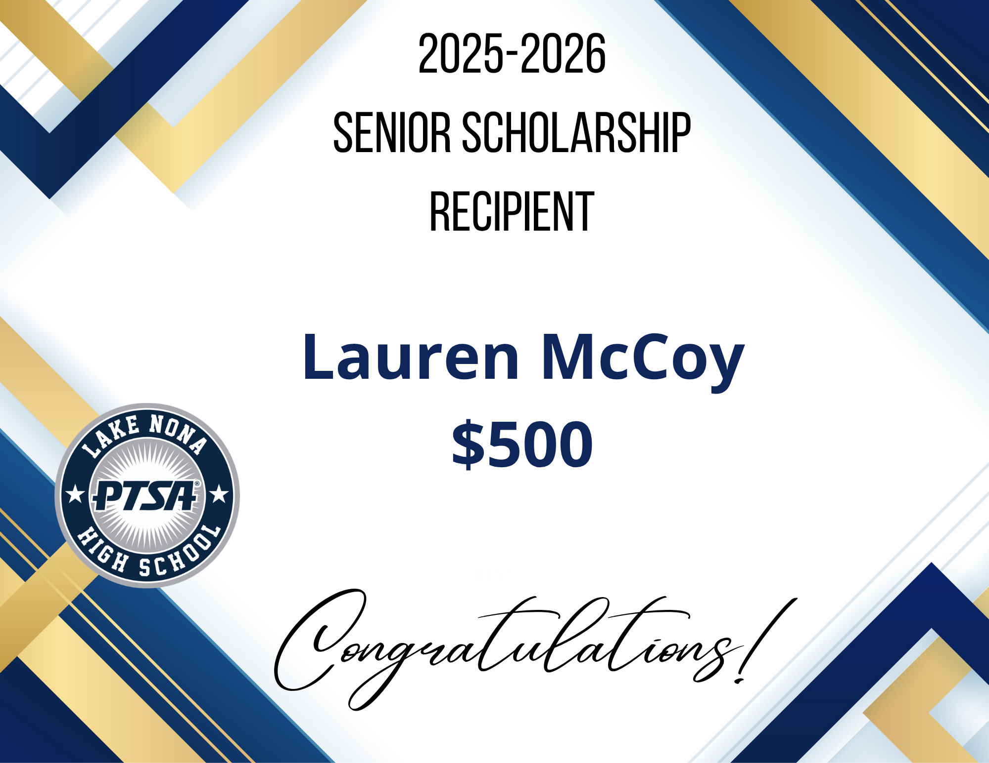

Slide 13


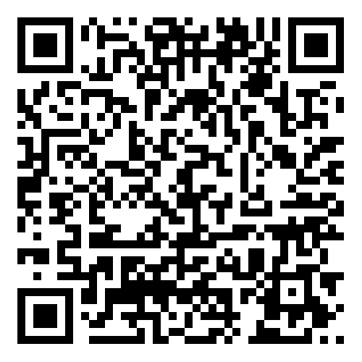

EMAIL - LNHSPTSA@gmail.com
WEBSITE - www.LNHSPTSA.com
Next Meeting - August TBD

